Slide 1
Deploying PowerBi Monitor Web Application
Modifying the Web Config, Registering AD Applications.

Slide 2
Web.Config
<appSettings>
<add key="webpages:Version" value="3.0.0.0" />
<add key="webpages:Enabled" value="false" />
<add key="ClientValidationEnabled" value="true" />
<add key="UnobtrusiveJavaScriptEnabled" value="true" />
<add key="SPA_ClientID" value=""/> <!--Demo_AdventureWorks_SPA-->
<add key="SPA_ClientSecret" value=""/>
<add key="Demo_AdventureWorks_SPA_NotAdmin" value="" /> <!--Demo_AdventureWorks_SPA_NotAdmin-->
<add key="Demo_AdventureWorks_SPA_NotAdmin_ClientSecret" value="" />
<add key="ida:Audience" value="https://dmsandbox.onmicrosoft.com/Demo_AdventureWorks" />
<add key="TenanntId" value="" />
<add key="RedirectUrl" value="http://localhost:13527/" />

Slide 3
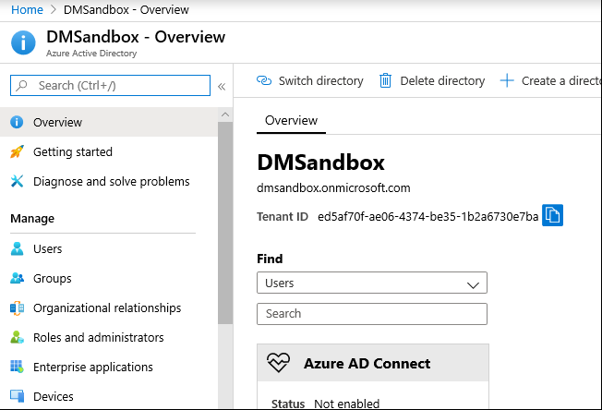
AD Tenant (Azure Active Directory->Overview)

Slide 4
Registering AD Applications
Azure Active Directory->App Registreation ->New Registration
Registering SPA and TheApp is mandatory
Registering SPA_NotAdmin is optional (in case you want to provide access to the app from non PowerBi admin account).
Registering the SPA app:

Slide 5
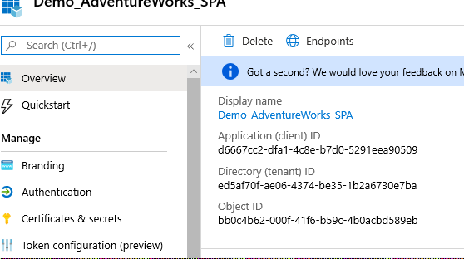
Client ID

Slide 6
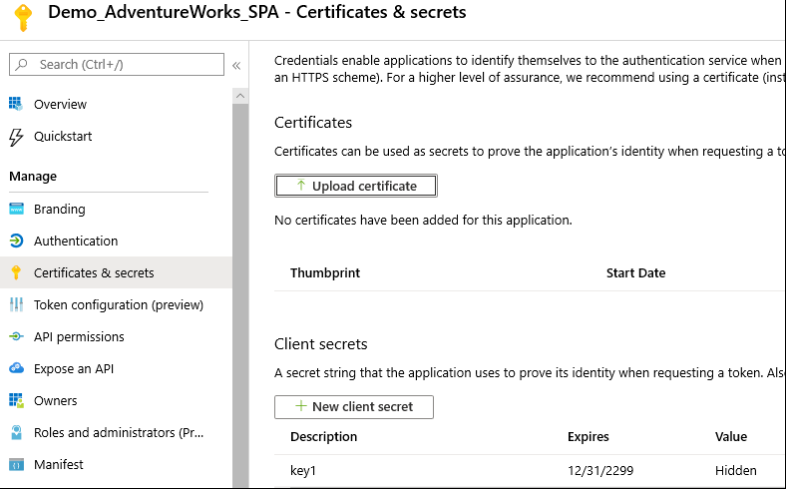
Client Secret (Certificates & secrets)

Slide 7
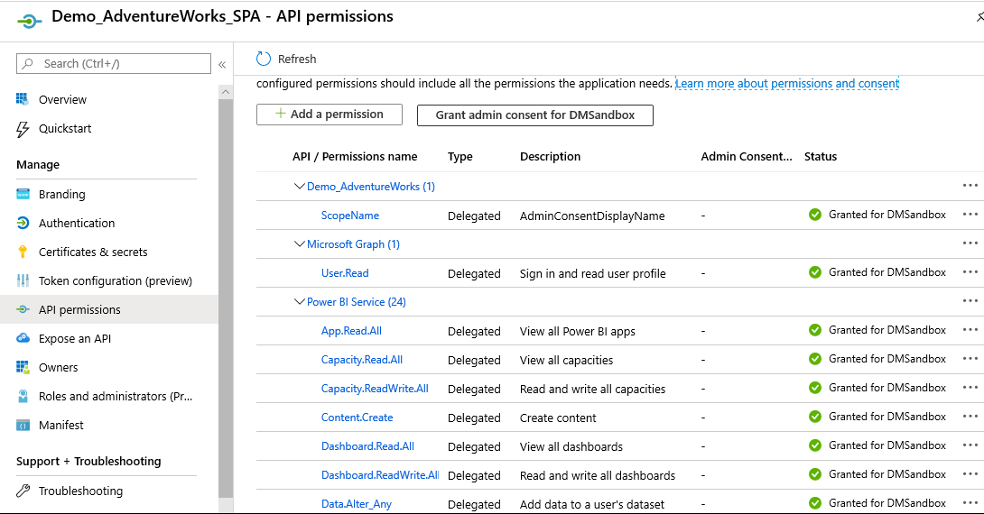
SPA Api permissions

Slide 8
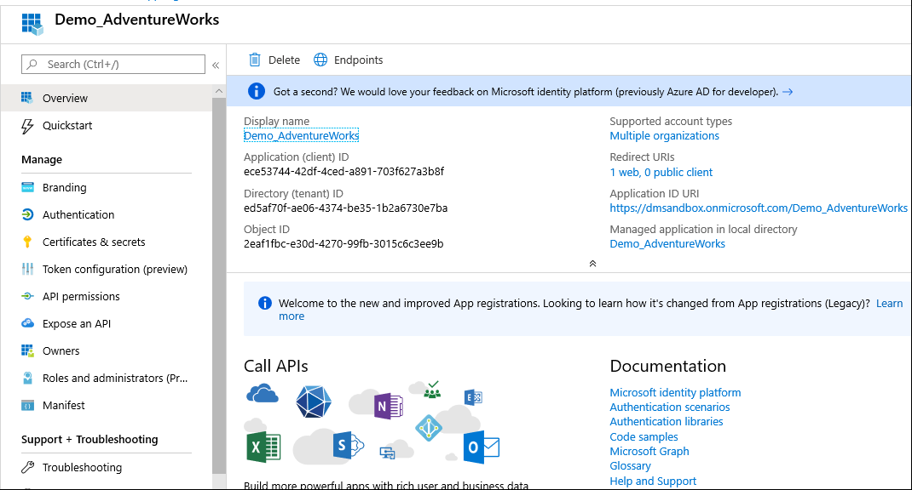
ida:Audience

